Slide 1

W241: SPACED VS. MASS STUDYING
SUMMER 2019 FINAL PRESENTATION
KEANE, ANU AND DAN

Slide 2
RESEARCH QUESTION
Do multiple shorter study sessions (spaced studying) improve learning over one longer study session (massed studying)?
Notes:
Keane:
One of the most persistent activities through life is learning. Although it is most associated with adolescence and school, learning is necessary as one moves through their career and takes on different roles, as well as in one’s leisure time in the pursuit of new hobbies or interests. As such, there is debate on what is the best, most time-effective method to learning. The two predominant schools of thought are: studying in a single longer session and studying in shorter sessions spaced over multiple days. Prior research has suggested that spaced learning may be more effective. However, an experiment is required in order to determine which of these methodologies people should implement. This leads to our research question: do multiple shorter study sessions (spaced studying) improve learning over one longer study session (massed studying)?

Slide 3
PRIOR RESEARCH
The prevailing theory is that shorter, spaced study sessions are more effective.

Slide 4
HYPOTHESIS
Our hypothesis is in line with this previous research.
We expect participants assigned to spaced studying sessions to have better recall than participants assigned to the massed studying session.

Slide 5
TREATMENT
Learn High Valyrian
Fictional language from Game of Thrones
Minimizes participants’ previous knowledge
Two treatment groups:
Spaced
Massed

Slide 6
MEASUREMENT UNITS
Individuals from:
Personal network
MIDS community
Notes:
Keane:
Most participants had at least a four-year college degree with some having graduate-level education as well. A majority of participants had basic proficiency with at least two languages. Just about all participants were familiar with Game of Thrones, but nearly all could not recognize High Valyrian outside of the show’s context.

Slide 7
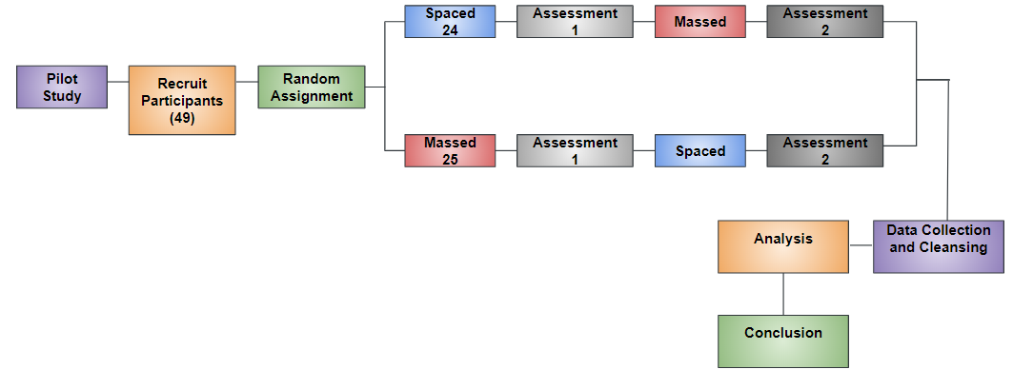
PROCESS FLOW

Slide 8
PILOT STUDY
3 Participants
Purpose was to test the process flow
Delivery of surveys on the qualtrics platform
Completed modules on duolingo.com
Prepared the assessments and took the tests
Exported data from qualtrics.

Slide 9
RANDOMIZATION
49 Participants
5 with self-assessed intermediate knowledge of High Valyrian
44 with self-assessed beginner level or no knowledge of High Valyrian
Block Random Assignment
Based on the previous knowledge level of High Valyrian

Slide 10

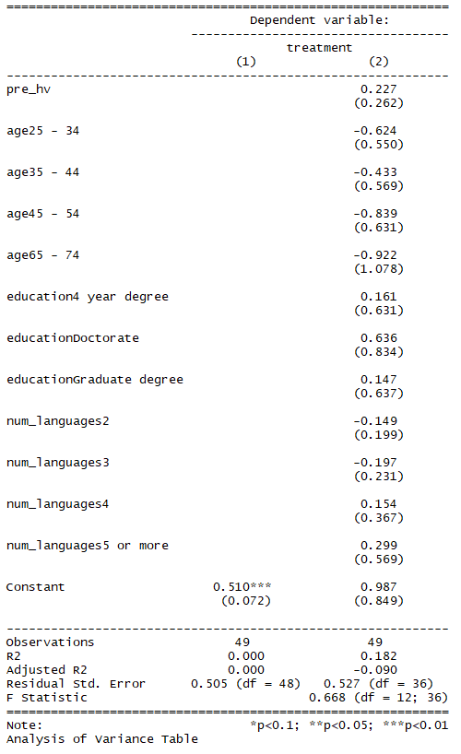
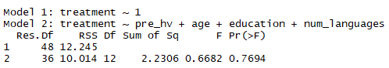
COVARIATE BALANCE
Conducted an F-test
Successful Randomization
Covariates are balanced
Notes:
Anu:

Slide 11
EXPERIMENTAL DESIGN
Grp. | Assign. | Pre- Treat | Day 1 | Day 2 | Day 3 | Day 4 | Day 5 | Day 6 | Day 7 | Day 8
3 | R | O | X_{1a} | X_{1a} | X_{1a} | O |  |  | X_{2b} | O
4 | R | O |  |  | X_{2a} | O | X_{1b} | X_{1b} | X_{1b} | O
Notes:
Anu:
The design has the benefit of measuring between subjects as well as within subjects treatment effect, which Dan will go over in detail as he presents the measured outcomes. But before we move on to that, here are some sample screenshots from our treatment.

Slide 12
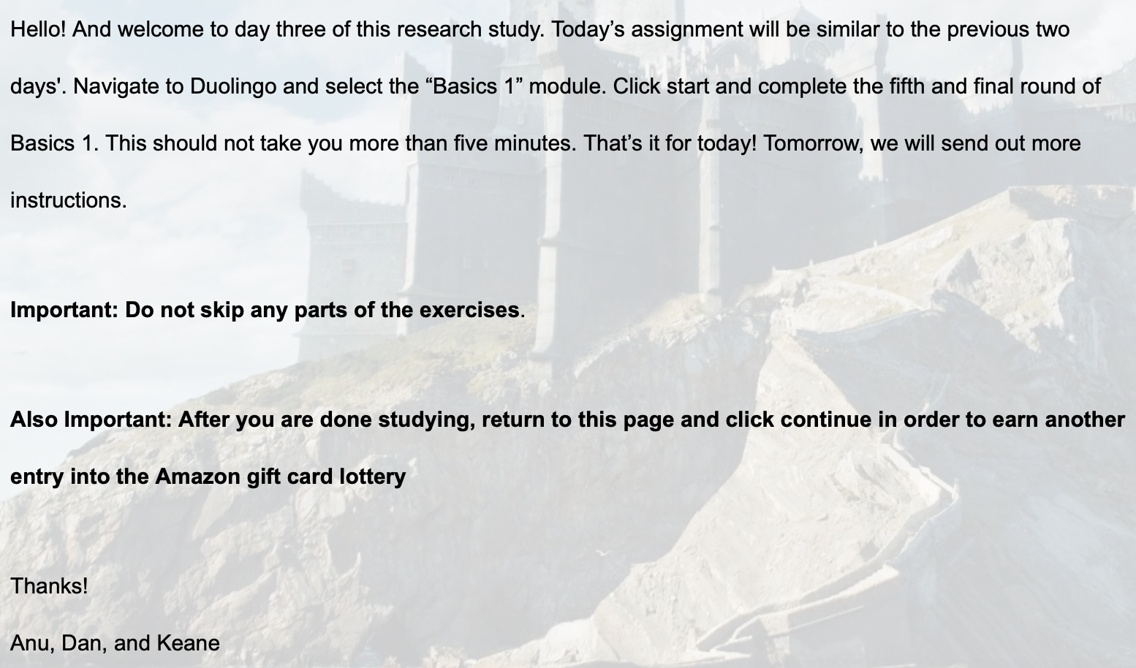
TREATMENT
Notes:
Keane:
Most participants had at least a four-year college degree with some having graduate-level education as well. A majority of participants had basic proficiency with at least two languages. Just about all participants were familiar with Game of Thrones, but nearly all could not recognize High Valyrian outside of the show’s context.

Slide 13
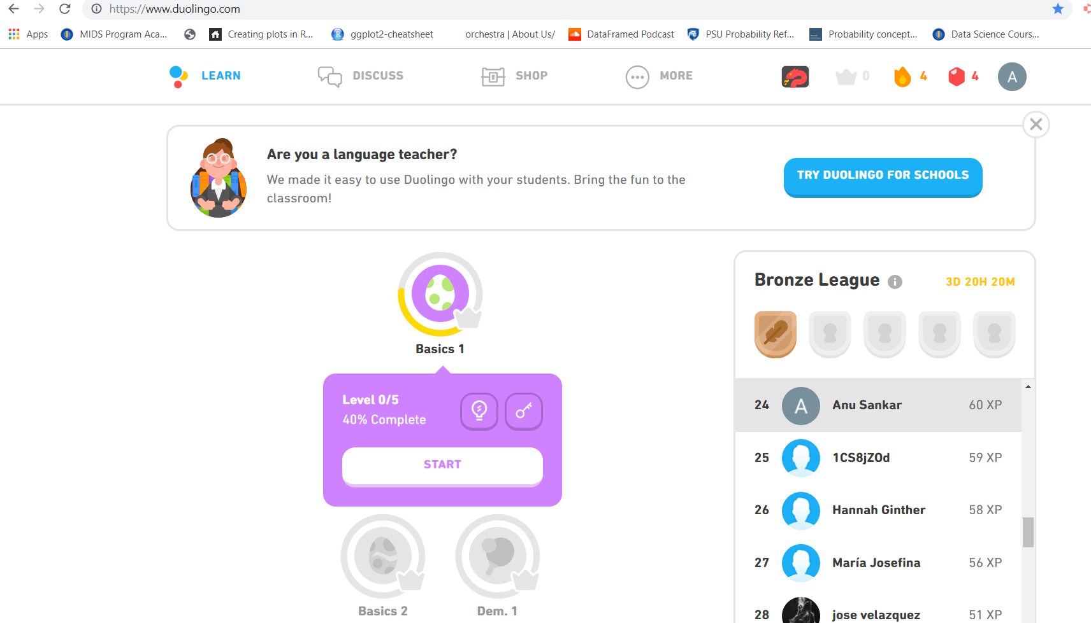
TREATMENT
Notes:
Anu:

Slide 14
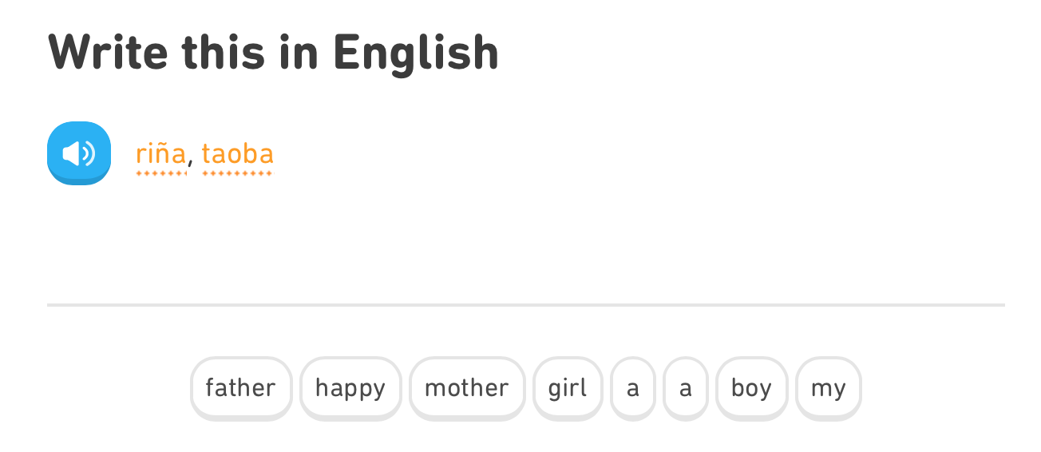
TREATMENT

Slide 15
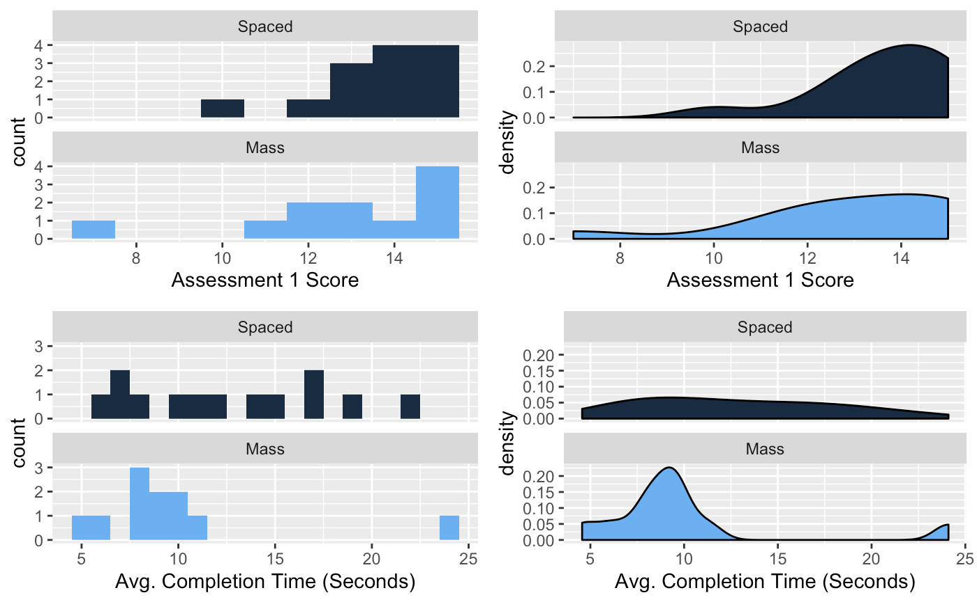
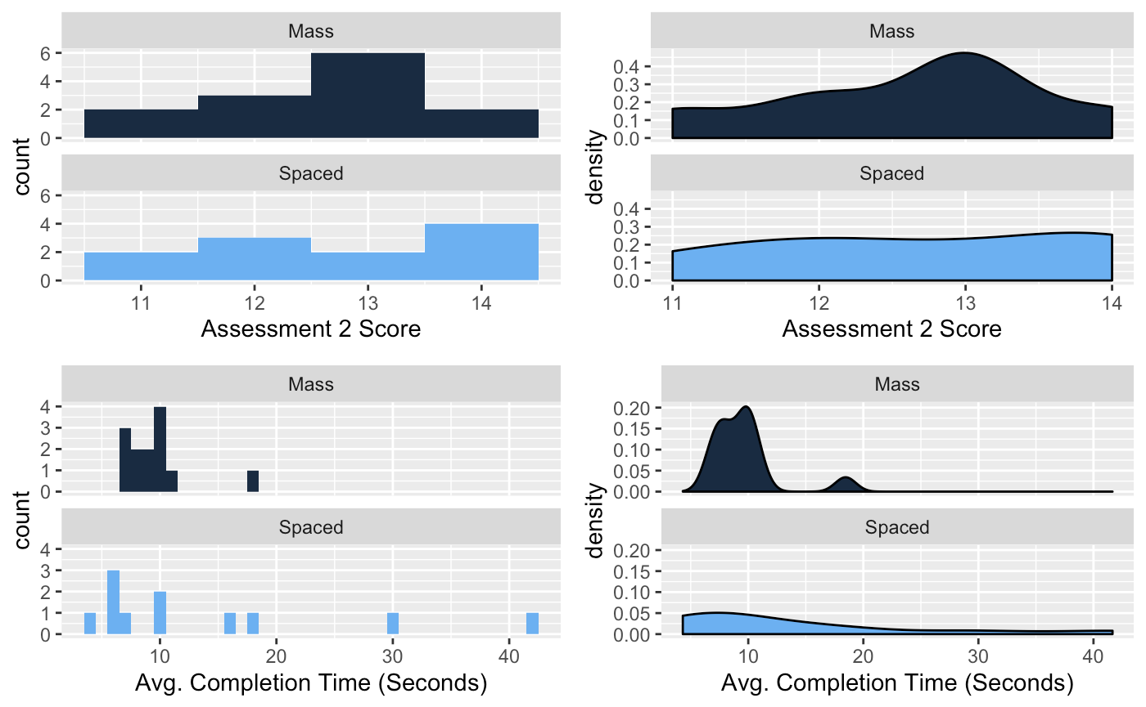
MEASURED OUTCOMES
SCORES AND SPEED
WHAT THESE OUTCOMES TELL US ABOUT TREATMENT EFFECTS ON LEARNER PRECISION AND RECALL

Slide 16
MEASURED OUTCOMES
SCORES AND SPEED
WHAT THESE OUTCOMES TELL US ABOUT TREATMENT EFFECTS ON LEARNER PRECISION AND RECALL
Assessment 1
Assessment 2

Slide 17
MEASURED OUTCOMES
𝝉₃
R | O | X_{1a} | X_{1a} | X_{1a} | O |  |  | X_{2b} | O
R | O |  |  | X_{2a} | O | X_{1b} | X_{1b} | X_{1b} | O
𝝉₁
𝝉₂
𝝉₄
SPACED STUDY
MASS STUDY
ASSESSMENTS

Slide 18
METHOD 1: SCORES (ITT)
𝝉₃: 1.0
R | O | X_{1a} | X_{1a} | X_{1a} | O |  |  | X_{2b} | O
R | O |  |  | X_{2a} | O | X_{1b} | X_{1b} | X_{1b} | O
𝝉₁: 0.7
𝝉₂: -0.18
𝝉₄: 0.11
SPACED STUDY
MASS STUDY
ASSESSMENTS

Slide 19
METHOD 1: SCORES (CACE)
𝝉₃: 1.15
(+0.15)
R | O | X_{1a} | X_{1a} | X_{1a} | O |  |  | X_{2b} | O
R | O |  |  | X_{2a} | O | X_{1b} | X_{1b} | X_{1b} | O
𝝉₁: -0.04 (-0.74)
𝝉₂: -0.22
(-0.04)
𝝉₄: 0.97
(+0.86)
SPACED STUDY
MASS STUDY
ASSESSMENTS

Slide 20
METHOD 1: SPEED (ITT)
𝝉₃: 3.7
R | O | X_{1a} | X_{1a} | X_{1a} | O |  |  | X_{2b} | O
R | O |  |  | X_{2a} | O | X_{1b} | X_{1b} | X_{1b} | O
𝝉₁: 2.7
𝝉₂: 5.1
𝝉₄: 6.1
SPACED STUDY
MASS STUDY
ASSESSMENTS

Slide 21
METHOD 1: SCORES (CACE)
𝝉₃: 3.2
(-0.5)
R | O | X_{1a} | X_{1a} | X_{1a} | O |  |  | X_{2b} | O
R | O |  |  | X_{2a} | O | X_{1b} | X_{1b} | X_{1b} | O
𝝉₁: 2.9
(+0.02)
𝝉₂: 4.2
(-0.9)
𝝉₄: 4.5
(-1.6)
SPACED STUDY
MASS STUDY
ASSESSMENTS

Slide 22
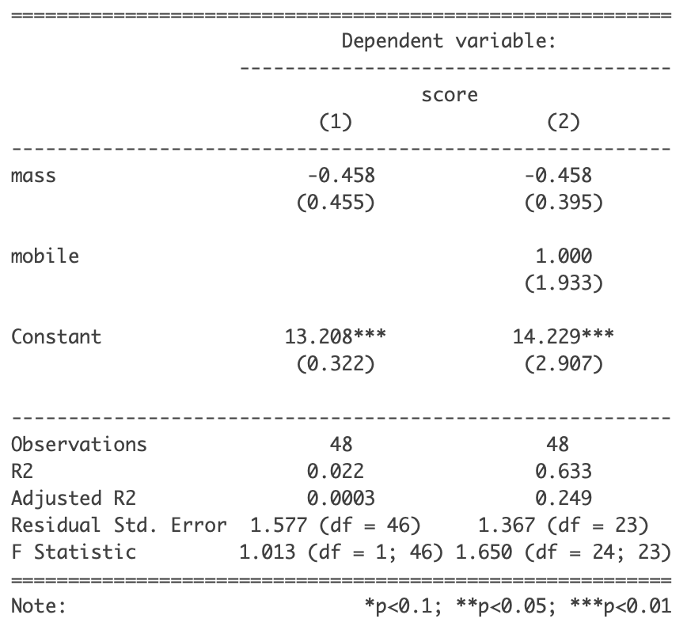
METHOD 2: SCORES
Spaced studiers score 0.458 points higher than crammers…
...but the result is not statistically significant.
Notes:
The distributions of Assessment 1 scores suggest that mass studying is more effective for a subset of participants, but on average produced lower scores with higher variability across the entire mass studying group, as compared to the spaced studying group. Interestingly, the effects are reversed for Assessment 2, where spaced studying appears to produce lower scores on average with higher variability in scores.

Slide 23
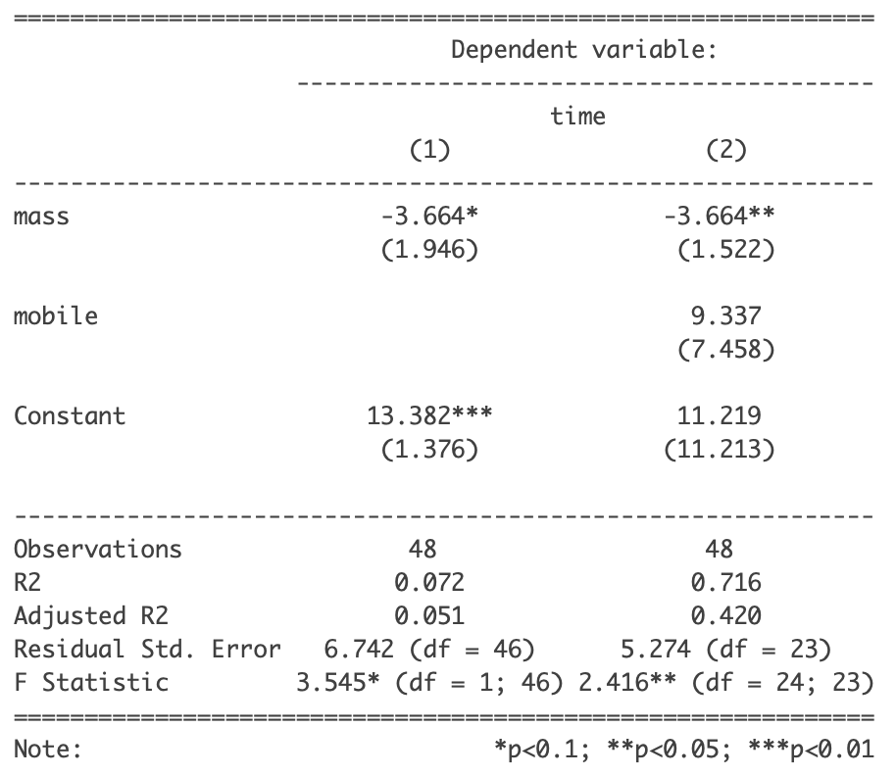
METHOD 2: TIMES
Crammers answer assessment questions 3.6 seconds faster than spaced studiers!
Notes:
Assessment 1 and Assessment 2 outcomes revealed more significant differences in the distribution of answer times for participants assigned to spaced studying vs. mass studying. The distributions of both Assessment 1 and Assessment 2 answer times suggest that mass studying produces relatively lower answer times than spaced studying.

Slide 24
QUESTIONS AND CONCERNS
Are our results because we did not include a wash out period after studying? How would our results have changed had we included one?
Repeating the experiment with more subjects might prove our hypothesis

Slide 25
APPENDIX

Slide 26
Bibliography
Smolen, Paul, et al. “The right time to learn: mechanisms and optimization of spaced learning.” Nature Reviews Neuroscience volume 17, pages 77–88 (2016). Link.
Division of Sleep Medicine at Harvard Medical School. “Sleep, Learning, and Memory.” Healthy Sleep. Link.
Kornell, Nate. “Optimising Learning Using Flashcards: Spacing Is More Effective Than Cramming.” Applied Cognitive Psychology 23: 1297–1317 (2009). Link.
Park, Denise, et al. “Theories of Memory and Aging: A Look at the Past and a Glimpse of the Future.” J Gerontol B Psychol Sci Soc Sci. 2017 Jan; 72(1): 82–90. Link.
Settles, Burr. “How we learn how you learn.” Making Duolingo. Link.

Slide 27
TOOLS
berkeley.qualtrics.com
Register Participants
Measure Compliance
Administer assessments to measure Outcomes
duolingo.com
To learn High Valyrian
Notes:
Keane:
Most participants had at least a four-year college degree with some having graduate-level education as well. A majority of participants had basic proficiency with at least two languages. Just about all participants were familiar with Game of Thrones, but nearly all could not recognize High Valyrian outside of the show’s context.

Slide 28
SLIDE TEMPLATES

